Slide 1

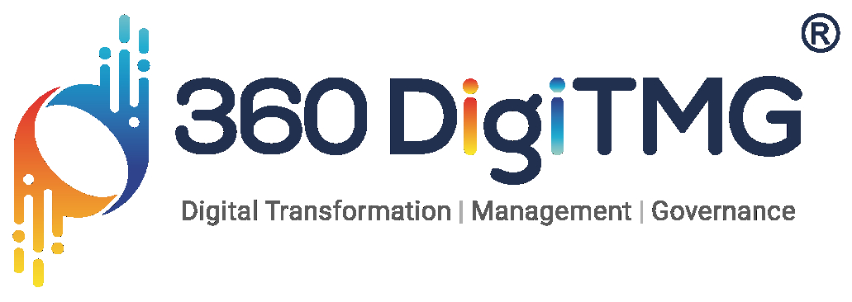

Project: Edubot: AI-Powered Learning Assistant for School Students
NAME- ANINDITA SAHA
NAME- ANINDITA SAHA

Slide 2
Project Overview and Scope
Develop an AI-powered chatbot that answers NCERT-based Class 10 Science queries.
Scope:
Extract and preprocess syllabus content
Use AI to answer questions within the academic boundary
Deploy an interactive chatbot UI

Slide 3
Contents
Business Objective:
Maximize student engagement
Improve learning efficiency through instant answers and explanations
Business Constraints:
Ensure chatbot restricts responses strictly to the NCERT syllabus
Avoid off-topic or general knowledge answers
Business Problem:
Traditional learning methods often fail to engage students effectively, leading to:
Reduced interest in subjects
Lack of personalized learning
Difficulty understanding complex concepts
Need: Schools require an AI-powered interactive solution that ensures responses remain syllabus-based.
Economic Success:
Affordable development and maintenance aligned with school budgets
Notes:
Change

Slide 4
Contents
Data Collection:
Source: NCERT Class 10 Science chapter-wise PDFs
Text extracted using PyMuPDF (fitz)
Images extracted and saved as PNGs from each PDF page
Exploratory Data Analysis:
Analyzed frequency of scientific terms
Explored word distributions across chapters
Checked for data completeness and imbalance
Success Criteria Business Success:
Increased academic engagement
Better academic performance

Slide 5
Project Architecture
Data Collection from NCERT PDFs
Text and Image Extraction
Data Preprocessing
Embedding & Vector Storage using FAISS
Integration with Gemini for contextual answering
Chatbot Deployment using Streamlit

Slide 6
Data Dictionary
Feature | Description
Chapter Name | Title of the Chapter
Raw Text | Unprocessed text extracted from PDFs
Cleaned Text | Preprocessed, lowercased, stopword-removed
Embeddings | Vector representations using spaCy
Images | Diagrams/images extracted from PDFs

Slide 7
Data Preprocessing
Converted text to lowercase
Removed special characters and punctuation
Tokenized using NLTK
Removed stopwords
Performed lemmatization and stemming (with spaCy)
Converted to dense embeddings using en_core_web_lg
Notes:
Keep observations

Slide 8
Exploratory Data Analysis [EDA]
Statistical Insights
Business Insights
Most frequent words: energy, reaction, force, etc.
Chapter with highest vocabulary density: ‘Life Processes’
Chapter with maximum image references: ‘Sources of Energy’
Science content is rich in terminology; ideal for keyword-based vector search
Embedding-based chapter retrieval increases relevance and accuracy
Image extraction supports visual learners and enhances interactivity
Notes:
EDA is used for seeing what the data can tell us before the modeling task.
Change

Slide 9
Deployment
FAISS used for fast similarity search of embeddings
Gemini API used for natural language responses
Streamlit used to create interactive UI with text input and image display

Slide 10
Query Logging & Database Integration
Content:
Purpose: Automatically store each student’s question into a MySQL database to monitor usage, improve responses, and perform further analysis.
Integration:
Captured user queries in real-time via Streamlit input.
Stored query text, timestamp, and top-matched chapters into MySQL.
Benefits:
Understand frequently asked questions
Identify content gaps or confusing topics
Enable future chatbot improvements and dashboard analytics

Slide 11
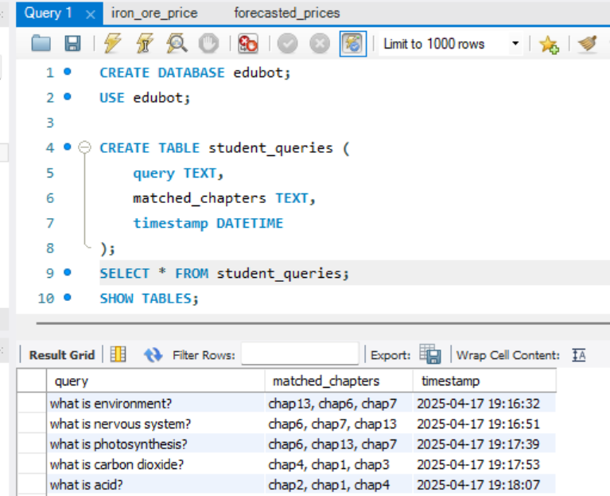

Slide 12
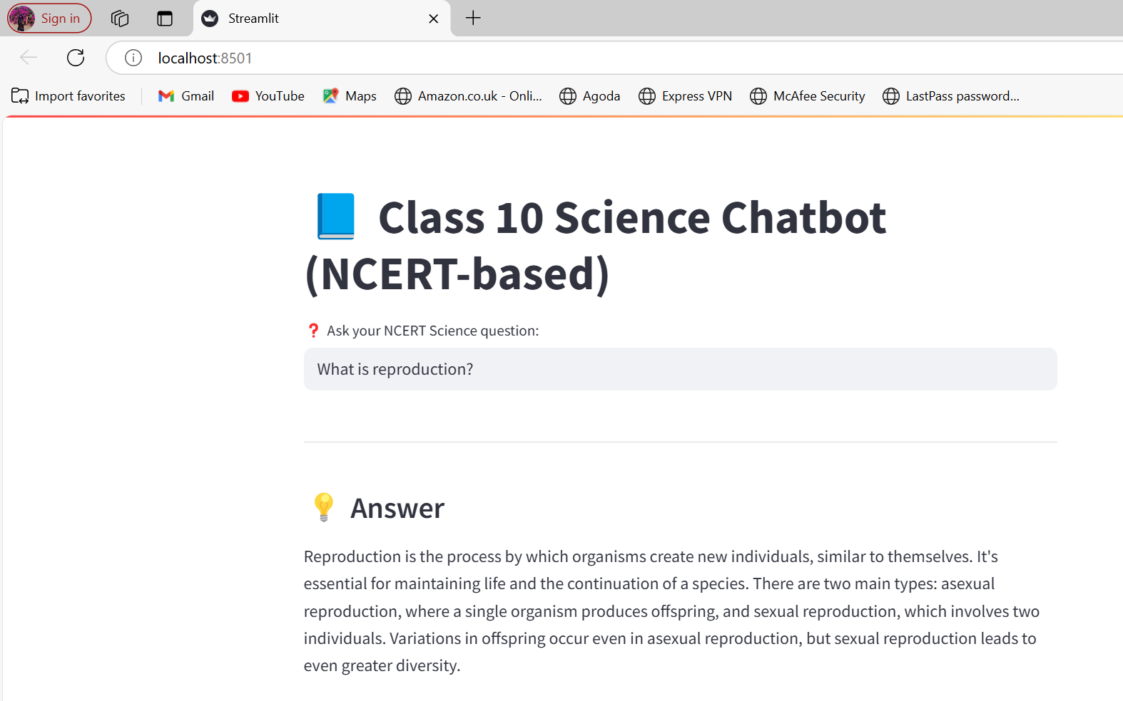
Data Visualization
Conclusion:
Edubot offers an engaging, syllabus-restricted AI tutor for students. By combining NLP, vector search, and generative AI, it enhances both the teaching experience and student understanding.
Notes:
Add graphical

Slide 13
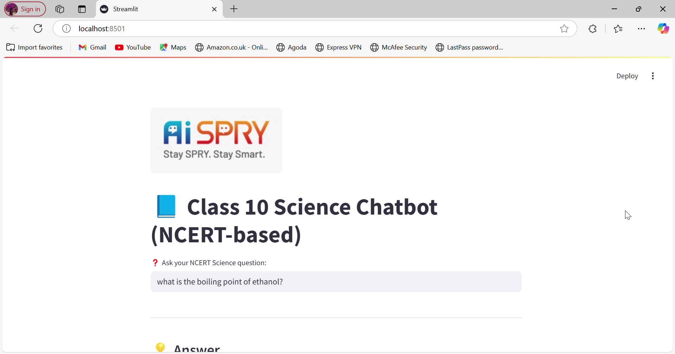
VIDEO

Slide 14


